Slide 1
KOWIN Eastern Region WASHINGTON D.C. CHAPTER
President: Myong Ho (Lucy) Nam

Slide 2
Programs
Regular Membership Meeting: Quarterly
Reports on previous quarter’s activities
Planning and discussion on remaining activities for the year
Educational seminar given by a member or invited guest speaker
Executive, Functional and Professional Committee Meetings:
Executive committee meeting: Annually held in January. Plan, discuss and delegate the KOWIN DC activities for the year.
Functional and Professional committee meetings: Held on demand, at least monthly. Plan and discuss details and execution of the assigned events.
Networking and Mentoring activities
Support for other non-profit community organization.
Hosting conference and seminar

Slide 3
Report on Activities (September, 2009 – August, 2010)
10-17-2009: 4th KOWIN Eastern Regional Leadership Conference – Sheraton Premier Hotel
12-6-2009: Year-End Party – Woo-Lae-Oak, 40 participants.
1-9-2010: Executive committee meeting – 12 participants.
Discussion on enhancing networking and mentoring program
Support for UN and Global Children Foundation (GCF): Donation for Haiti children’s support fund to GCF ($1,000)
“The Korean council for the women drafted for Military Sexual Slavery by Japan” and Women’s Human Rights Museum Building Fund: Donated $1,000
2-23-2010: Regular membership meeting – Financial Educational Seminar for Women: New tax codes and regulations on Investment: 25 participants.
6-27-2010: Regular membership meeting – Seminar on “Women & Nutrition”: 20 participants.
7-7,8-2010: Anyang Women’s College Students’ Visit as Visiting program for the Next Generation Women’s Leadership Program – Interviews on KOWIN DC members, Julie Koo and Sue Vittas-Shin
7-7-2010: Committee meeting – Palm restaurant, Tyson’s corner.

Slide 4
New Planned Programs
KOWIN DC Website
KOWIN DC Newsletter
Organization of Professional Networking Groups

Slide 5
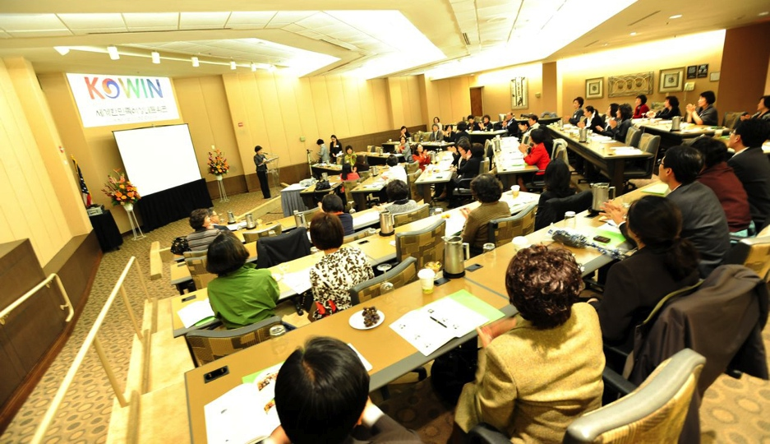
The 4th Eastern Regional Leadership Conference
October 17, 2009: Hosted by KOWIN DC Chapter
Theme: Cultivating Community Leaders & Fostering Global Think Tankers!

Slide 6
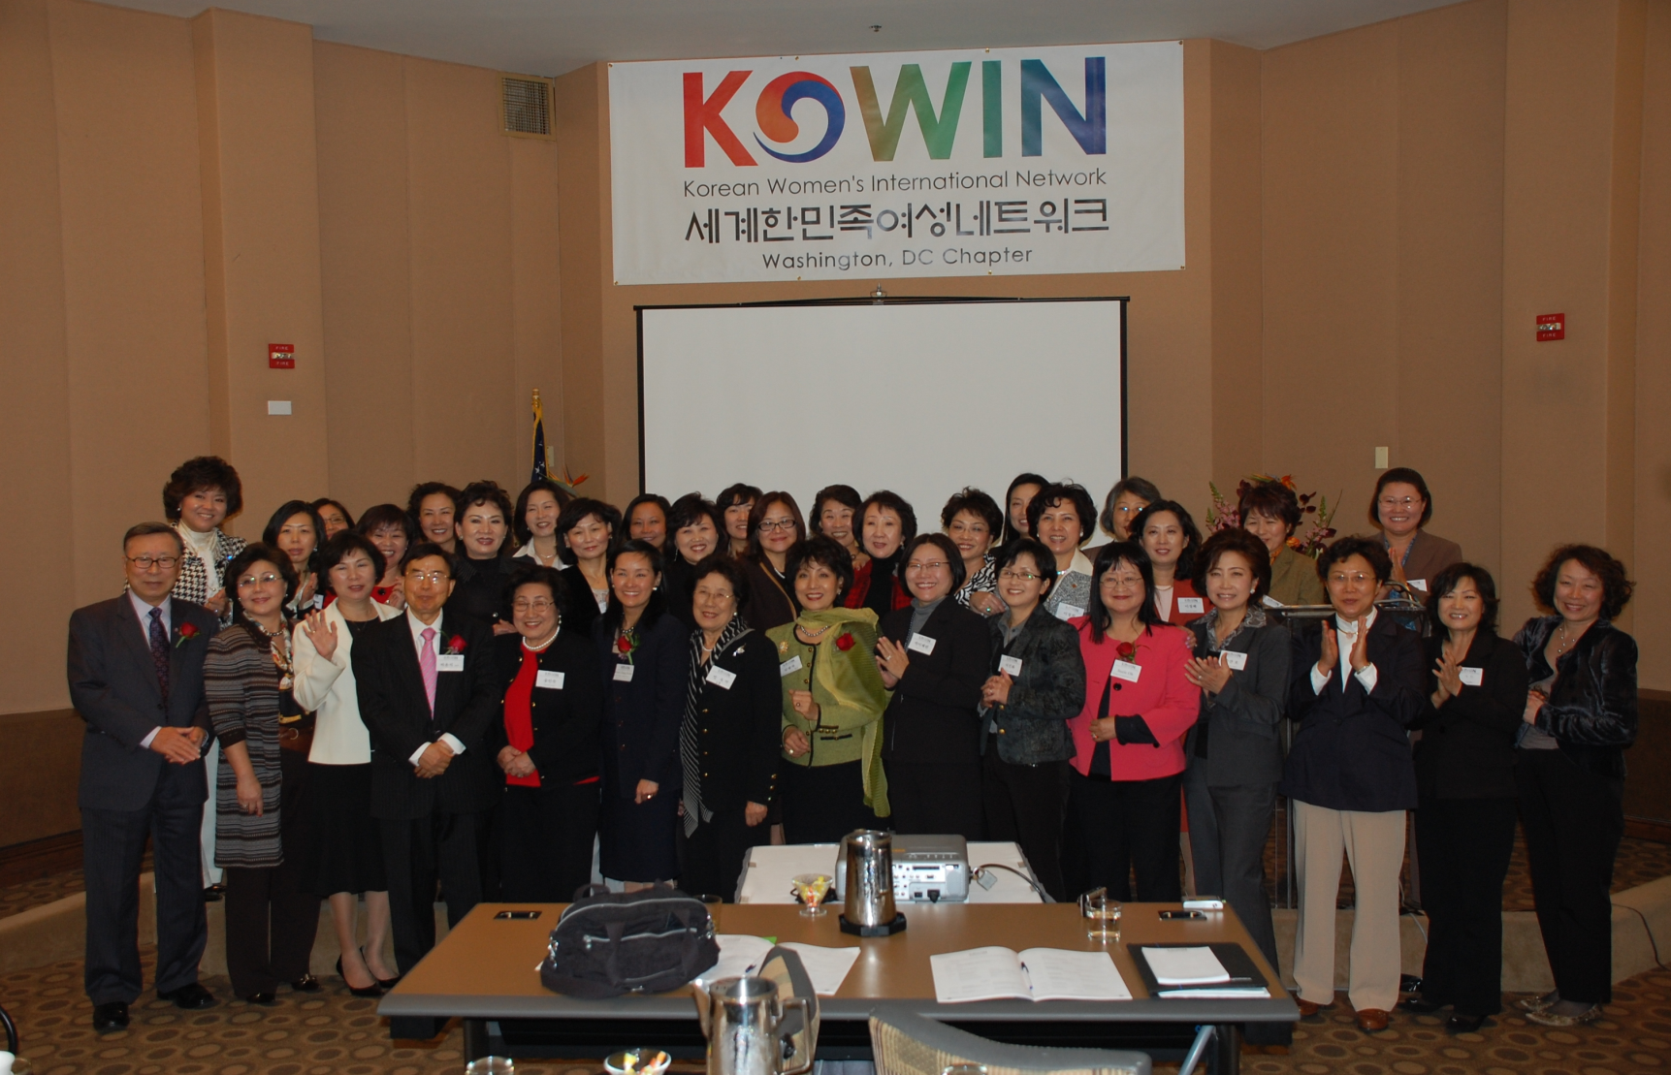

Slide 7
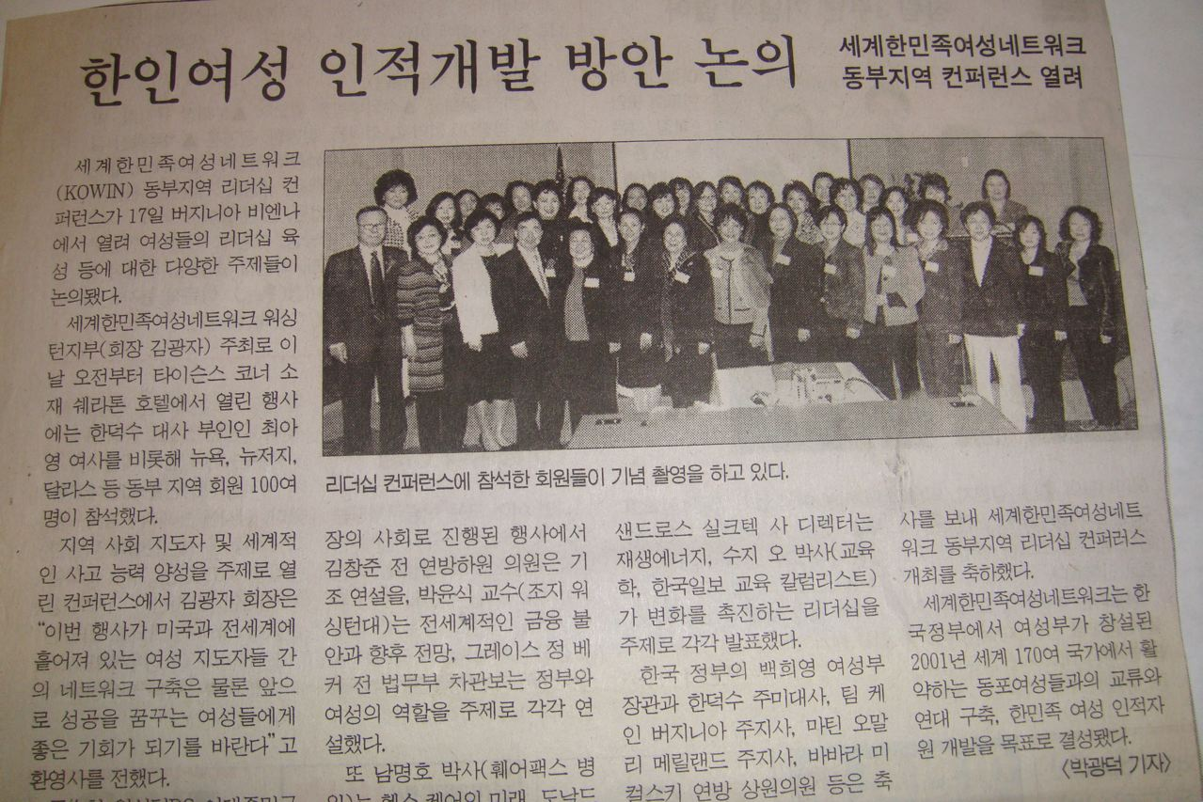

Slide 8
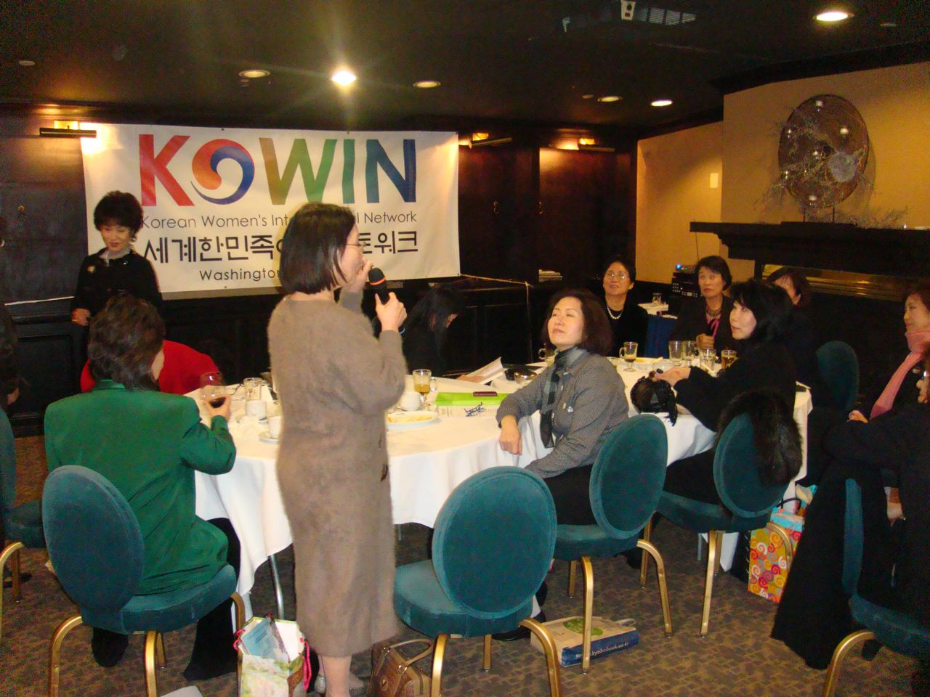
2009 Year-End Party & Regular Membership Meeting
December 6, 2009: Woo-Lae-Oak

Slide 9
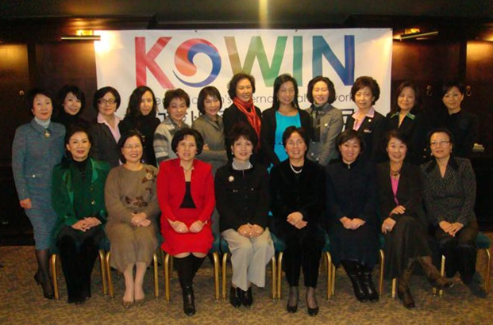

Slide 10
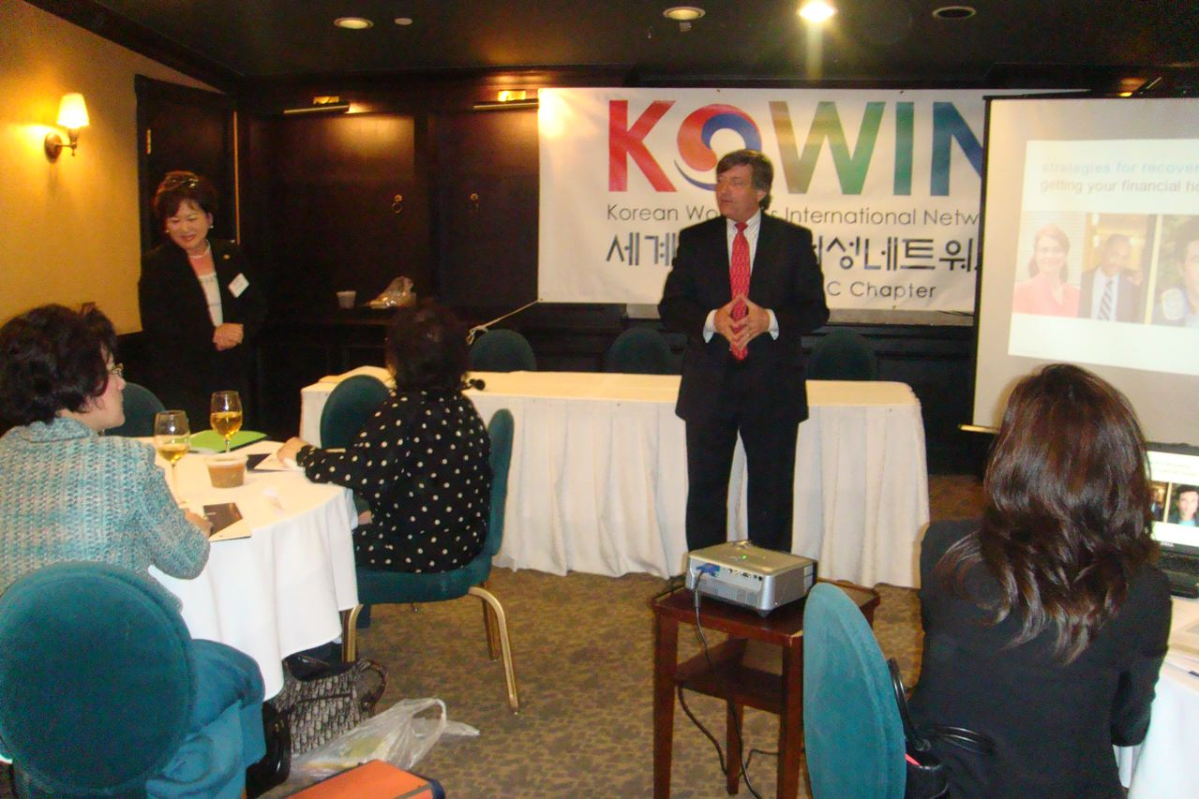
Seminar for Women on New Tax Law
February 23, 2010: Regular Membership Meeting – Woo-Lae-Oak

Slide 11
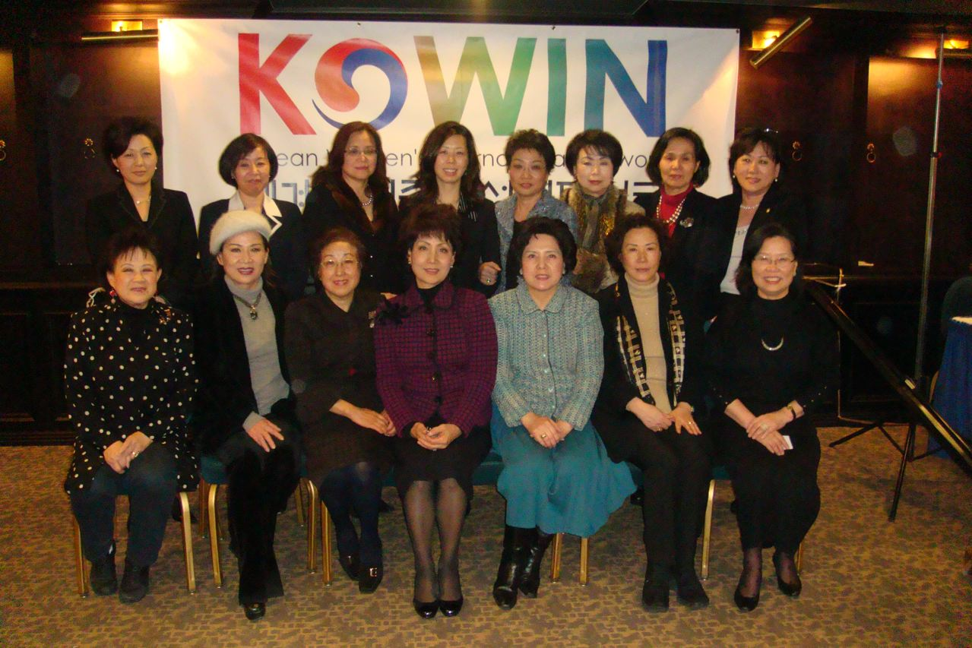

Slide 12
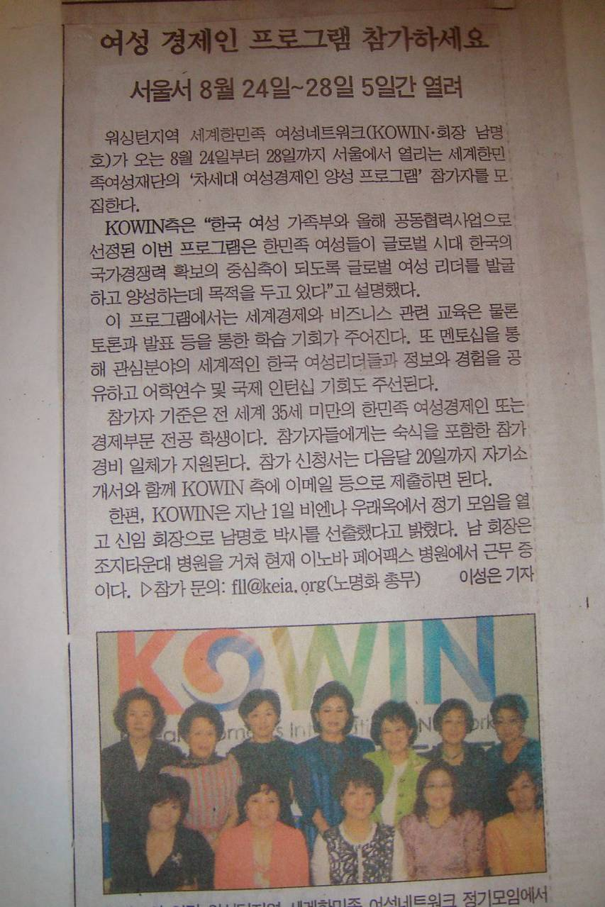

Slide 13
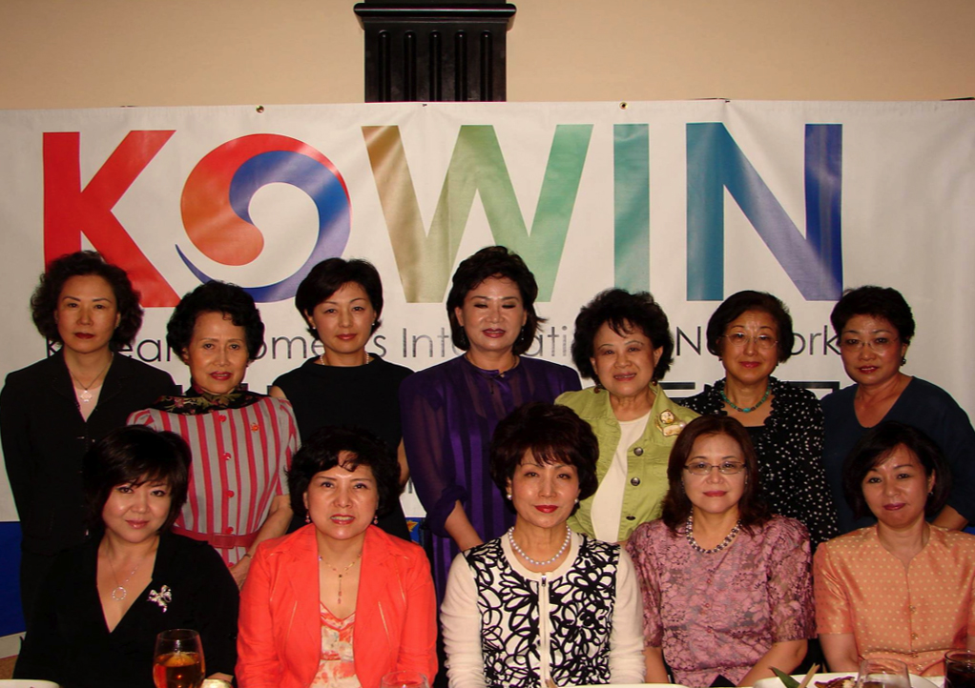

Slide 14
2010 2nd Regular Membership Meeting
June 1, 2010: Woo-Lae-Oak, Tyson’s Corner
Attendants: Kwang Ja Kim, Marina Kim, Hongja Kim, Myong Ho Nam, Florence Lowe-Lee, Sun-sook Shin, Sue Vittas-Shin, Susan Oh, Myung Ja Lee, Eun Ae Lee, Jung Hee Lee, Connie Chung, Eun Ok Cho, Sami Lauri (14 participants)
Next KOWIN DC President Elected: Myong Ho Nam, M.D.
Graduate of Seoul National University College of Medicine. Medical director of Clinical Laboratory Services at Inova Fairfax Hospital.
New president interested in promoting Korean Women’s Networking and collaboration with other organizations in Washington DC metropolitan area, and establish KOWIN DC as a model organization.
Executive members: Jung Hee Lee (Vice President); Florence Lowe-Lee (Executive Secretary); Sami Lauri (Secretary); Myung Ja Lee (Finance).
Participants for the Busan 10th KOWIN International Convention:
Kwang Ja Kim, Hongja Komrelia O’Kim, Myong Ho Nam, Florence Lowe-lee, Sue Vittas-Shin, Myung Ja Lee, Jung Hee Lee, Sami Lauri (total 8)
Seminar on “Women & Nutrition“: By Eun Ae Lee - “Psychological Effect of Nutrition” on 6-27-2010, 4:30 PM at McLean Presbyterian Church with Dr. Soo-Woong Han.

Slide 15
Committee Meeting & Project Interview on Future Women Leaders
July 7, 2010: Palm Restaurant, Tyson’s Corner
KOWIN DC Executive Committee Members & Three students from Anyang Women’s College attended
KOWIN DC Members Interviewed:
Sue Vittas-Shin: Senior IT Officer Team Leader, IMF
Soo-Hyun (Julie) Koo: Director of Asian & Pacific Islander Affairs, DC Mayor’s Office
Florence Lowe-Lee: Coordinator and Secretary for the events - Treasurer & Director of Finance, KEI.

Slide 16
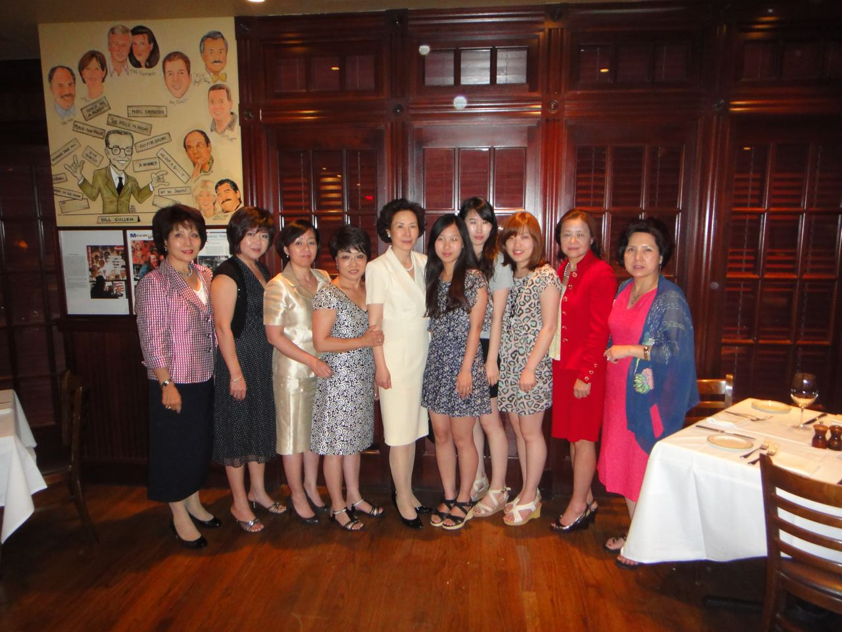

Slide 17
Programs for the remaining 2010
8-14-2010: Committee Meeting – Brainstorming Session
9-28-2010: Regular Membership Meeting - Report on the Busan 10th KOWIN International Convention
10-12-2010: Planning Meeting for Next Generation Women Leadership Mentoring Seminar to be held in November 21, 2010.
11-9-2010: Professional Committee Meeting
12-28-2010: Regular Membership Meeting & Fundraising Christmas Party

